Slide 1
Migration From Drupal 7 to 8 and 9
Prerequisites :
Difference Between Drupal 7 Vs. Drupal 8
Drupal 7 Module Vs. Drupal 8 Module
Drupal 7 Custom Module Vs. Drupal 8 Custom Module
Drupal 7 Content Type Vs. Drupal 8 Content Type
Drupal 7 View Vs Drupal 8 view
Drupal 7 Theme Vs Drupal 8 Theme
Drupal 7 Custom theme Vs Drupal 8 Custom theme
Drupal 7 Folder Structure Vs. Drupal 8 Folder Structure
Drupal 7 Procedural PHP Vs Drupal 8 Object Oriented PHP
Drupal 7 Procedural PHP Vs Drupal 8 MVC
Drupal 7 without framework Vs. Drupal 8 Symfony Framework
Drupal 7 Coding Standard Vs. Drupal 8 Coding Standard

Slide 2
Migration From Drupal 7 to 8 and 9
Prerequisites :
Drupal 7 Hooks Vs Drupal 8 Hooks
Using Twig , YAML, Route, Namespace, Design Pattern, Coding Pattern, Dependency injection in Drupal 8
Drupal 7 Drush Vs. Drupal 8 Composer
Drupal 7 Block Vs. Drupal 8 Block
Drupal 7 MySQL Database Structure Vs Drupal 8 MySQL Database Structure
Knowing About Drupal 8 Migration Modules
Knowing Rules & Regulation during migration From Drupal 7 to Drupal 8
Drupal 7 to Drupal 8 Migration Limitation
Types & Way of Migration
Knowing About Manual Migration
Drupal 8 Upgrade Preparation steps

Slide 3
Migration From Drupal 7 to 8 and 9
Benefits of Drupal 8 Upgrade
Entrepreneurs are keen to upgrade their existing websites from Drupal 7 to Drupal 8 because these versions (7 and 8) are going to reach their end of lives in 2021. Here’s why:
It is easy to build mobile-friendly websites with Drupal 8 webform as it seamlessly supports mobility.
Drupal 8 modules support more than 100 languages which helps you expand your website’s global reach.
Drupal 8 download lets you set-up multiple sites with one database. It has built-in web-services, so your website can integrate with any number or system or applications.
Content creation and management are more natural with Drupal 8 upgrade as it integrates the WYSIWYG editor at its core.
You get better SEO rankings with Drupal 8 installation because it supports HTML5 that has a cleaner structure and new semantic elements.
Drupal 8 themes achieve full marks on its customer expectations as it offers user-friendly content creation and a smoother interface.

Slide 4
Drupal 7 VS Drupal 8
Drupal Modules
There is a different collection of "modules" available for Drupal, which have been developed by a community of developers and shared for public use. These can be installed onto a website to increase its functionality. Some contrib modules are in Drupal 8 core such as:
CKEditor
The CKEditor module builds on Drupal 8's Text Editor module to provide a deeply integrated CKEditor text editor out of the box. Unlike the contributed module in Drupal 7, the CKEditor module in Drupal 8 core
Core Multilingual
Drupal 8 accelerated multilingual website development by including four key modules in the core. While using Drupal 8, the developers can avail new modules like language, content translation, interface translation, configuration translation. The modules make it easier for users to configure language and apply to the content as well as translate the website.
Views & Views UI
Using the Views module, you can fetch content from the database of your site and present it to the user as lists, posts, galleries, tables, maps, graphs, menu items, blocks, reports, forum posts etc. Different content types including nodes, users, and other bundles can be displayed.

Slide 5
Drupal 7 VS Drupal 8
Breakpoint
Breakpoints are used to separate the height or width of viewports (screens, printers, and other media output types) into steps and
provide for the case where a responsive design adjusts in order to display correctly on different devices. The Breakpoints module standardizes the use of breakpoints, and enables modules and themes to expose or use each others' breakpoints. The Breakpoint module keeps track of the height, width, and resolution breakpoints.
Configuration Manager
The Configuration Manager module is responsible for managing the collection of admin settings that determine how the site functions, as opposed to the content of the site. Configuration will typically include things such as the site name, the content types and fields, taxonomy vocabularies, and so on.
Media
The core Media module provides a 'base' entity for media assets. This allows you to standardize the way your Drupal site interacts with media resources. Local files or images, YouTube videos, Tweets, Instagram or Facebook posts, etc. can all be treated in a common way, regardless of where the media resource itself is ultimately stored. Being a standard Drupal content entity, you can reference and use this new entity in any place Drupal knows how to work with them.
Once installed, you will have the media entity type available. Just like with Nodes, with this new entity type you can create Media Types, add fields to them, manage display modes (for view and form operations), and so on.

Slide 6
Drupal 7 VS Drupal 8
Drupal Core
Drupal 8 also added two field types into core listed below:
1- Datetime
The Datetime module provides a Date field that stores dates and times. It also provides the Form API elements datetime and datelist which other modules can make use of.
2- Telephone
The Telephone module allows you to create fields that contain telephone numbers.
It depends on the Field and the Field UI modules.
As with other fields a telephone field can be added to any bundle. This means you can add a telephone field to a user, a content type (news, event) or custom block.
Drupal 8 vs Drupal 7: New Theme Engine
Theme engines are how themes interact with Drupal. Drupal 8 comes with a new theme engine –Twig. Twig is a PHP-based theme engine which allows programmers to write templates using a simpler syntax. But the developers can still use Twig to crate templates which are both fast and secure. Hence, the developers can take advantage of the new theme engine provided by Drupal 8 to create beautiful and functional websites according to varying business needs.

Slide 7
Drupal 8 Core Migrate Modules
About the core Migrate modules
Migrate: Migrate module provides the APIs for importing data to Drupal 8 from any data source.
Migrate Drupal: Migrate Drupal module provides the capabilities for importing data from Drupal 6 and Drupal 7 to Drupal 8. Migrate Drupal uses the APIs and underlying capabilities provided by the Migrate module.
Migrate Drupal UI: Migrate Drupal UI provides the browser user interface for Migrate Drupal. Drupal 6 / Drupal 7 upgrades to Drupal 8 can also be executed with Drush using contributed modules
Migrate Drupal Multilingual: Upgrading non-multilingual Drupal 6/7 sites to Drupal 8 is significantly more mature than upgrading multilingual sites. The experimental Migrate Drupal Multilingual module is required by all Drupal 6/7 to Drupal 8 migrations that are dealing with multilingual data.

Slide 8
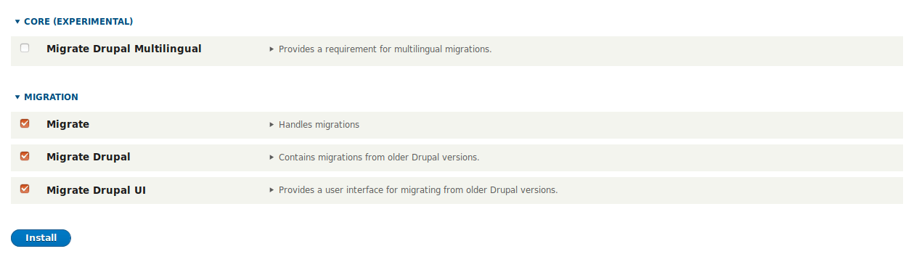
Drupal 8 Core Migrate Modules

Slide 9
Drupal 8 Contributed Migrate Modules
Migrate Upgrade
https://www.drupal.org/project/migrate_upgrade
Provides the migrate-upgrade Drush command for generating the migrations from a Drupal source site.
Migrate Tools
https://www.drupal.org/project/migrate_tools
Provides Drush commands and tools such as migrate-status, migrate-import, migrate-rollback, migrate-stop, migrate-reset-status, migrate-messages, migrate-fields-source.
Migrate Plus
https://www.drupal.org/project/migrate_plus
Provides APIs for grouping migrations as well as a facility to manipulate incoming source data in migrations as well as code examples to build custom migrations.

Slide 10
Important Points with Migration
Enable required core and contributed modules in Drupal 8
Do not configure the Drupal 8 site
Do not create content on the Drupal 8 site
Performing the upgrade
You have two choices to actually execute the migration:
Using the browser user interface. This is the easier method and it can be done through the user interface of the Drupal 8 site. However, it offers less control over the migration.
Using Drush. This is more robust and faster and allows selective migration but it requires additional modules and it must be run from the command line.

Slide 11
Important Points with Migration
Enable required core and contributed modules in Drupal 8
The migration process does not automatically install modules on the Drupal 8 destination site. Only migrations relevant for modules installed on both the source and destination site will be executed. Therefore you need to first enable all core and contributed modules on the Drupal 8 site for which you want to migrate configuration and content from the source site.
If you have the Drupal 7 core Forum module enabled on your source site, you must enable the core Forum module on your Drupal 8 site before beginning the upgrade process.

Slide 12
Important Points with Migration
Do not configure the Drupal 8 site
Keep in mind that the upgrade process will overwrite configuration on the Drupal 8 site, so do not do any configuration of the Drupal 8 site until after the upgrade process is complete. This means you do not have to create all the content types and fields manually before running this upgrade. The Migrate module will create them as a part of the migration process. In fact, it is a common best practice to install Drupal 8 using the Minimal install profile, because the Standard profile introduces its own configuration that you might not want to use. This is different than the way Migrate worked in Drupal 7 and earlier, where you had to have all the content types and fields prepared and ready before running Migrate.

Slide 13
Drupal 8 Core Migrate Modules
Additional Considerations
Not all contributed modules have automatic upgrade paths. This may require a manual or custom migration.
Drupal 8 significantly changed how themes are structured. These changes can't be migrated. Instead, a theme must be rebuilt to work in Drupal 8.
Although there are automated tools available, setting these up can still be a complex process. If a site does not have much content or custom configuration, some users may find it easier/faster to manually create this data in the new site. This should be determined on a per-case basis.

Slide 14
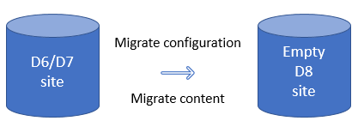
Drupal 8 Core Migrate Modules
Examples of configuration migration: Content types, field definitions, and user roles are configuration entities which can be migrated to Drupal 8.
Examples of content migration: Nodes, users and taxonomy terms are examples of content entities which can be migrated to Drupal 8.

Slide 15
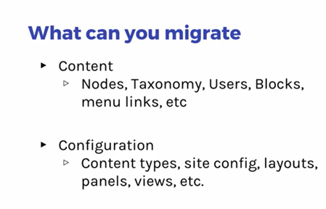
Drupal 8 Core Migrate Modules

Slide 16
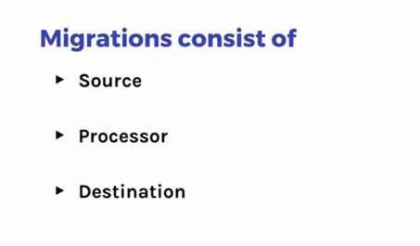
Drupal 8 Core Migrate Modules

Slide 17
Drupal 8 Core Migrate Modules
ETL Process
Migration is nothing but an Etract –x Transform – Load (ETL) process. In the Drupal Migrate API:
Extract phase is called source (could be applications, databases & systems)
Transform phase is called process (set of business rules)
Load phase is called destination (the targeted system can be data warehouses, analytical applications, or data marts)

Slide 18
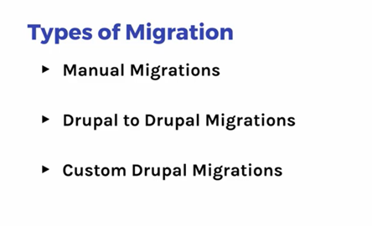
Drupal 8 Core Migrate Modules

Slide 19
Migration Preparation steps
Upgrade a site by importing its files and the data from its database into a clean and empty new install of Drupal 8
Definitions
Old site
The site you want to upgrade.
New site
This empty Drupal 8 installation you will import the old site to.
Preparation steps
Take the Backup Of Old Website
Put this site into maintenance mode.
Make sure that access to the database for the old site is available from this new site.
If the old site has private files, a copy of its files directory must also be accessible on the host of this new site.
Enable all modules on this new site that are enabled on the old site. For example, if the old site uses the Book module, then enable the Book module on this new site so that the existing data can be imported to it.
Do not add any content to the new site before upgrading. Any existing content is likely to be overwritten by the upgrade process.

Slide 20
Pre-requisites for upgrading from Drupal 6 / 7 to Drupal 8
A fresh installation of Drupal 8 with the core modules 'Migrate' and 'Migrate Drupal' enabled. If you're upgrading to Drupal 8 using the browser user interface, you will also need to enable 'Migrate Drupal UI' core module.
Access to the Drupal 6 or 7 database from the host where your new Drupal 8 site is.
Access to the source site's files.
If only public files are used, they will be accessible through the site's address.
If private files need to be migrated, the files directory needs to be directly accessible to the new Drupal 8 site and you must configure the Drupal 8 file_private_path path in settings.php before running the upgrade.
If you're upgrading to Drupal 8 using Drush, you will also need Drush 8 or Drush 9 and three contributed modules.
Installation instructions for Drush are included on the page linked above.
Install Migrate Tools
Install Migrate Upgrade
Install Migrate Plus
For more information on the modules listed above, please refer to the list of upgrade modules.

Slide 21
Migration Drupal 7 to Drupal 8 & 9
Steps :
Install New Drupal 7
Add Some Basic Page, Article page, User & Do Some Configuration with Drupal 7
Install New Drupal 8
Enable the Drupal 8 Migration Modules (Migrate, Migrate Drupal, Migrate Drupal UI)
Also enable the all modules of Drupal 7 inside the Drupal 8
Go to the Configuration of Drupal 8 and select upgrade ( upgrade UI extend configuration)
Configure the migration :
Drupal 7 Database name, user name & password
Website Local Public URL ( c:/xampp/htdocs/drupal7)
Website Local Private URL ( c:/xampp/htdocs/drupal7)
Start Migration
Check the Website Basic Page, Article page, Configuration etc
Successfully Migration happened from Drupal 7 to Drupal 8

Slide 22
Migration Drupal 7 to Drupal 8 & 9
DEMO

Slide 23
Most Common Drupal 7 to Drupal 8 Migration Issues
Oops! My Video Field Content and Configuration Have Not Migrated!
Link Field Without Contents: One of the Popular Drupal 7 to Drupal 8 Migration Issues
“Full HTML”, “Filtered HTML” and Other Filter Formats Haven't Migrated
Content Won't Show on My Drupal 8 Site: “Page Not Found” Error
Both Field and Content Migrated, But Without Field Configurations

Slide 24
Most Common Drupal 7 to Drupal 8 Migration Issues
Oops! My Video Field Content and Configuration Have Not Migrated!
Solution :
create a video field in the YouTube Video module. Then, rely on your script for migrating your video content to Drupal 8.
Link Field Without Contents: One of the Popular Drupal 7 to Drupal 8 Migration Issues
Solution:
It's due to a field configuration mismatching!
you just need to reconfigure your field settings, to write a script in order to migrate your content to your Drupal 8 website. Remember to save your internal and your external link differently when you save your link through the your script!
“Full HTML”, “Filtered HTML” and Other Filter Formats Haven't Migrated
Solutions
You can always adopt a “create a new custom script” method! It's the solution that will help you set the right format.

Slide 25
Most Common Drupal 7 to Drupal 8 Migration Issues
Content Won't Show on My Drupal 8 Site: “Page Not Found” Error
Solution:
It might be a more than common “I forgot to copy the .htaccess file from my Drupal 7 website” scenario.
Both Field and Content Migrated, But Without Field Configurations
Solution :
Well, going manual is, again, the most reliable method for fixing it. Manually configure your settings in this case!

Slide 26
Most Common Drupal 7 to Drupal 8 Migration Solutions
Porting drupal 7 module to drupal 8 Use Drupal Module Upgrader
The Drupal Module Upgrader is a Drush command that helps you update your modules from Drupal 7 to Drupal 8.
Installing the module
This module requires drush 8 or above, Assuming that the drush 8 installed in your system if it isn’t please visit how to install drush with the composer. Use the following Drush commands
drush dl drupalmoduleupgrader
cd modules/drupalmoduleupgrader
composer install
drush en drupalmoduleupgrader
drush dmu-analyze MODULE_NAME
drush dmu-upgrade MODULE_NAME

Slide 27
Migration Drupal 7 to Drupal 8 & 9
References
Ultimate Guide: How to Migrate Drupal 7 To Drupal 8 For 2020 (cmsminds.com)
How to Upgrade a Drupal 7 Site to Drupal 8 | HostAdvice
How to upgrade your website from Drupal 7 to Drupal 8 (bacancytechnology.com)
Drupal 7, 8 and 9 Migration: Step by step Guide (clariontech.com)
Drupal 7 to Drupal 8 migration with configuration entities | Colorfield (Migration Using Drush)
10 Reasons Why You Need To Migrate From Drupal 7 to Drupal 8 (etondigital.com)

